Slide 1
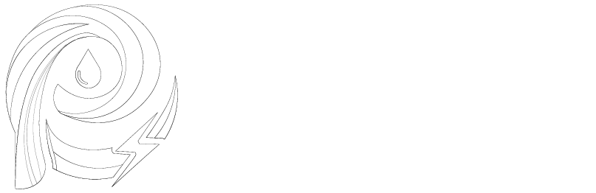
Harmonics in Electrical Power Systems and Their Impacts

Slide 2
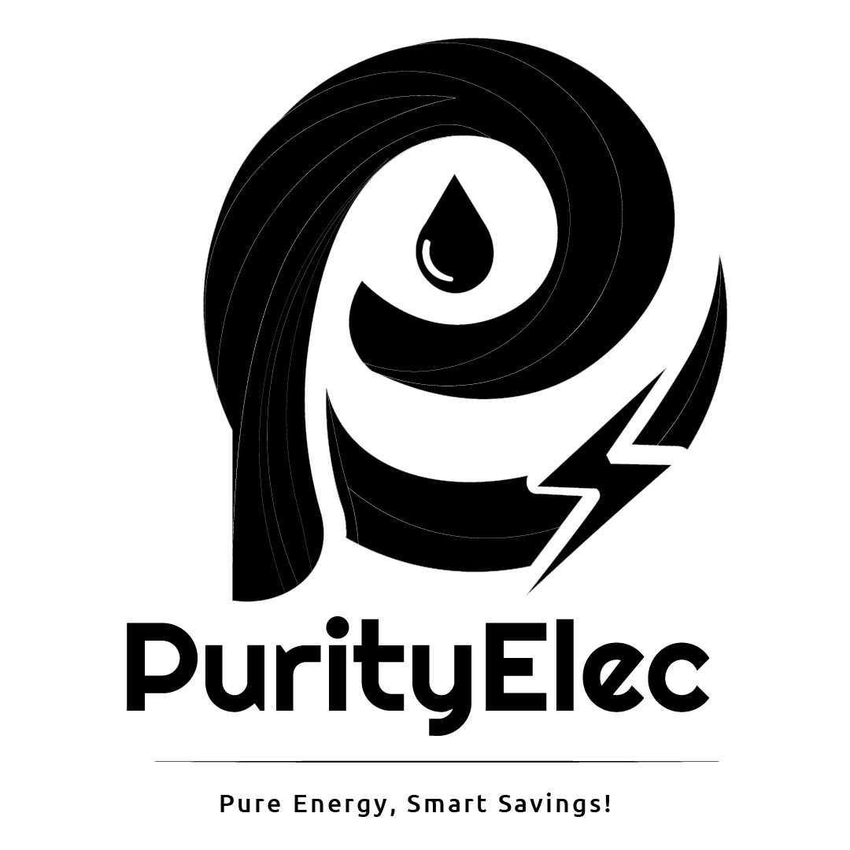
📌 What is Frequency?
In Alternating Current (AC), frequency refers to the number of cycles the AC waveform completes in one second. It represents how quickly the current changes direction and is measured in hertz (Hz).

Slide 3

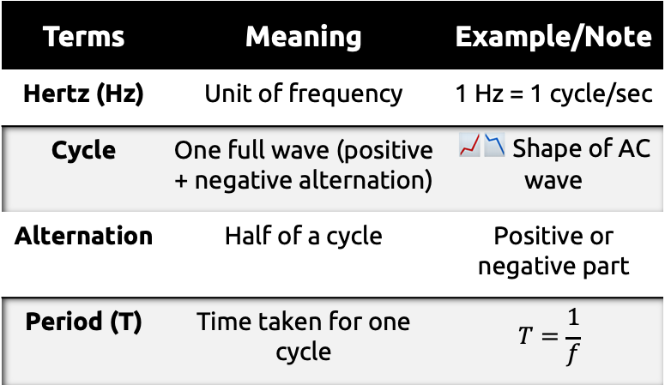
🧩 Key Concepts
Terms | Meaning | Example/Note
Hertz (Hz) | Unit of frequency | 1 Hz = 1 cycle/sec
Cycle | One full wave (positive + negative alternation) | 📈📉 Shape of AC wave
Alternation | Half of a cycle | Positive or negative part
Period (T) | Time taken for one cycle | $$T=\frac{1}{f}$$

Slide 4
🔍Visual Representation
Show a sine wave with:
  One full cycle marked
  Alternations (positive/negative halves)
  The period (T) marked on the time axis
Example visual labels:
↑ Voltage
│ /‾‾‾\ /‾‾‾\
│ / \ / \
│ / \_/ \_ Time →

Slide 5
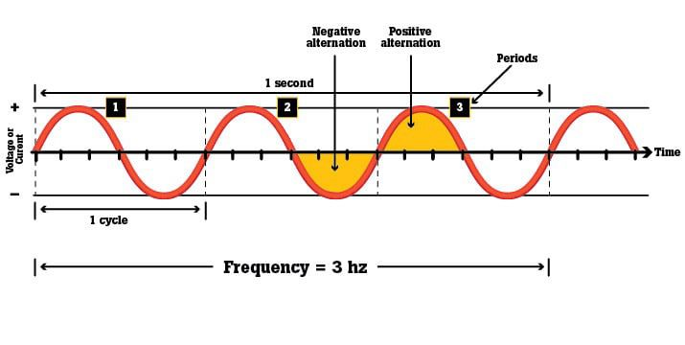

Slide 6


Example:
If AC frequency = 3 Hz:
  3 cycles occur in 1 second
  Period (T) = $\frac{1}{3}$seconds = 0.333 s per cycle
📌 Real-world reference:
  India → 50 Hz
  USA → 60 Hz

Slide 7
📌 Frequency Standards
India → 50 Hz (Fundamental Frequency)
Some other countries → 60 Hz
Meaning:
  50 Hz = 50 complete cycles per second
📌 Harmonics
Harmonics are frequencies that are integer multiples of the fundamental frequency.

Slide 8

Formula:
Harmonic Frequency = Fundamental Frequency X n
where n = harmonic order (1, 2, 3, …)
Example for 50 Hz fundamental:
  1st Harmonic → $50×1=50 \text{Hz}$
  2nd Harmonic → $50×2=100 \text{Hz}$
  3rd Harmonic → $50×3=150 \text{Hz}$
  4th Harmonic → $50×4=200 \text{Hz}$
  5th Harmonic → $50×5=250 \text{Hz}$
  …and so on.

Slide 9
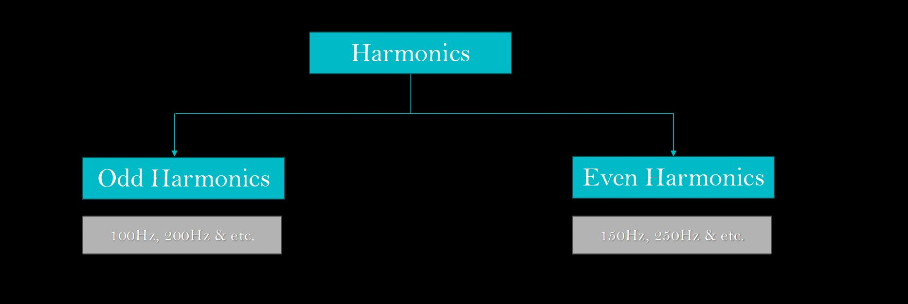

Slide 10
📌 Harmonics in Power Systems
Even vs Odd Harmonics:
Even Harmonics → Normally do not exist in power systems.
Odd Harmonics → Do exist and can have harmful effects on electrical networks and machines.
Harmonic Order | Frequency (Hz) | Impact
1st | 50 × 1 = 50 Hz | ✅ Good (Fundamental)
3rd | 50 × 3 = 150 Hz | ❌ Bad
5th | 50 × 5 = 250 Hz | ⚠️ Dangerous
7th | 50 × 7 = 350 Hz | ❌ Bad
9th | 50 × 9 = 450 Hz | ❌ Bad
11th | 50 × 11 = 550 Hz | ❌ Bad
13th | 50 × 13 = 650 Hz | ⚠️ Slightly Bad

Slide 11
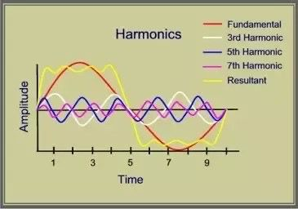
📍 Note:
These harmonic orders are commonly found in industries.
As the harmonic order increases, its impact on the electrical network decreases.

Slide 12
📌 Types of Harmonics in Power Systems
1️⃣ Zero Sequence Harmonics (Triplens)
Cause:
  Single-phase or two-phase loads
  Examples: SMPS, LED lighting, personal computers, office electronics
Effect:
  Circulates between neutral and phase conductors
  Causes high neutral current
Other Name: Zero Sequence Harmonics / Triplens

Slide 13
2️⃣ Negative Sequence Harmonics
Cause:
  VFDs, UPS, transformers, generators, welding machines, furnaces
Effect:
  Most dangerous type of harmonic
  Causes motors to rotate opposite to the intended direction
Other Name: Negative Sequence Harmonics

Slide 14
3️⃣ Negative Sequence Harmonics
Cause:
  VFDs, UPS, transformers, generators, welding machines, furnaces
Effect:
  Frequency components rotate in the same direction as the fundamental AC frequency
Other Name: Positive Sequence Harmonics

Slide 15
📌 Impact of Harmonics on Electrical Networks
🔴 Problem:
Harmonics increase actual current consumption in the network.
This creates extra load on:
Transformers
Diesel Generators (DGs)
Busbars
Cables

Slide 16
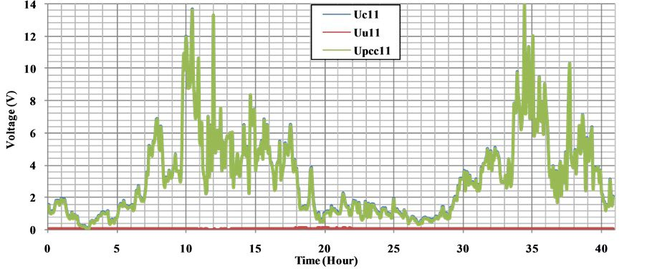
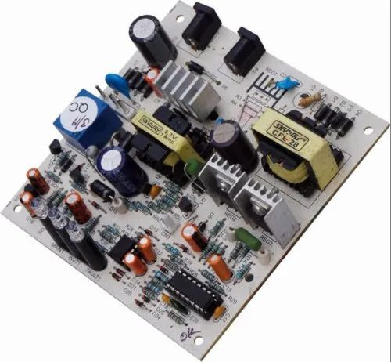
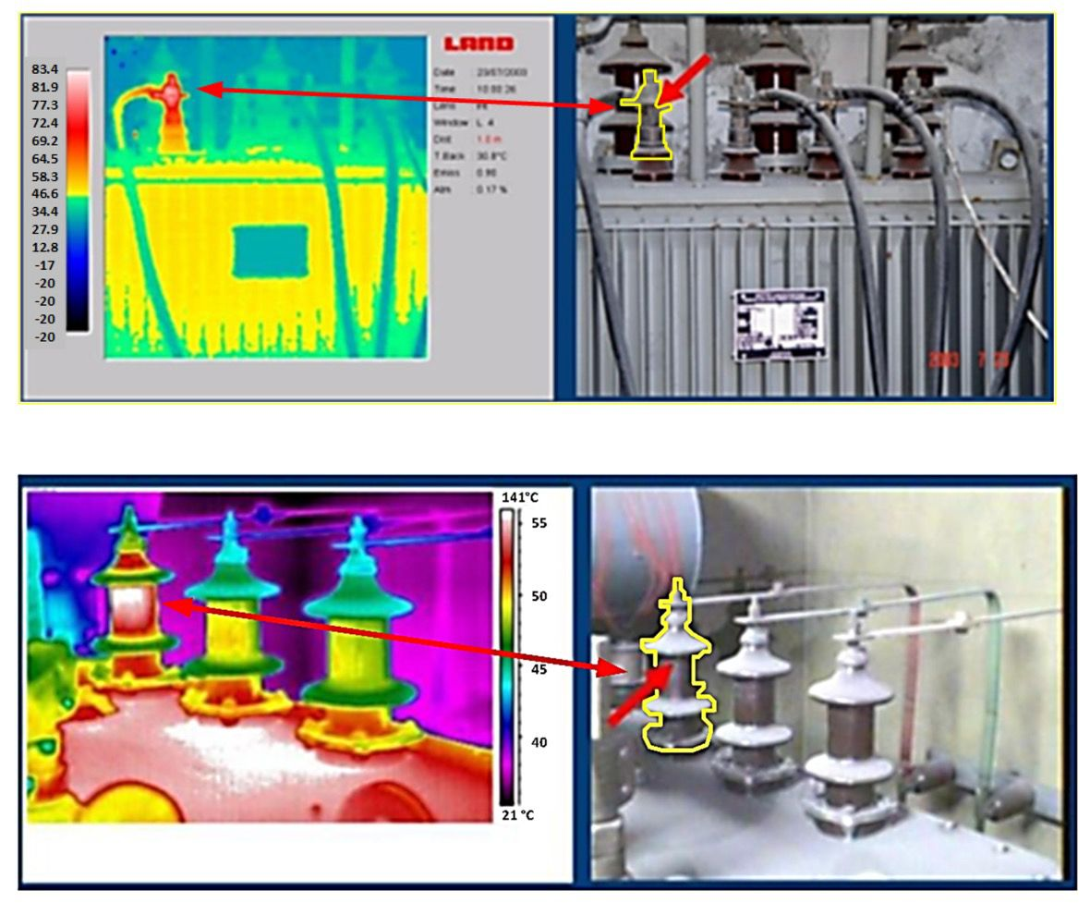
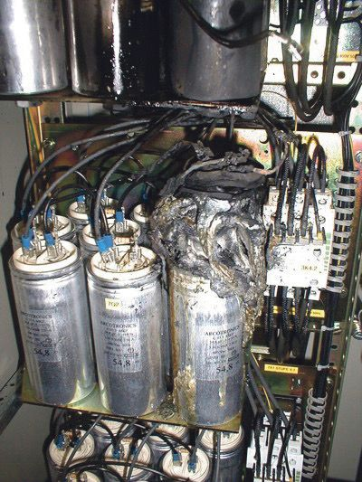
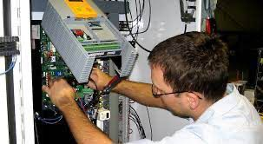
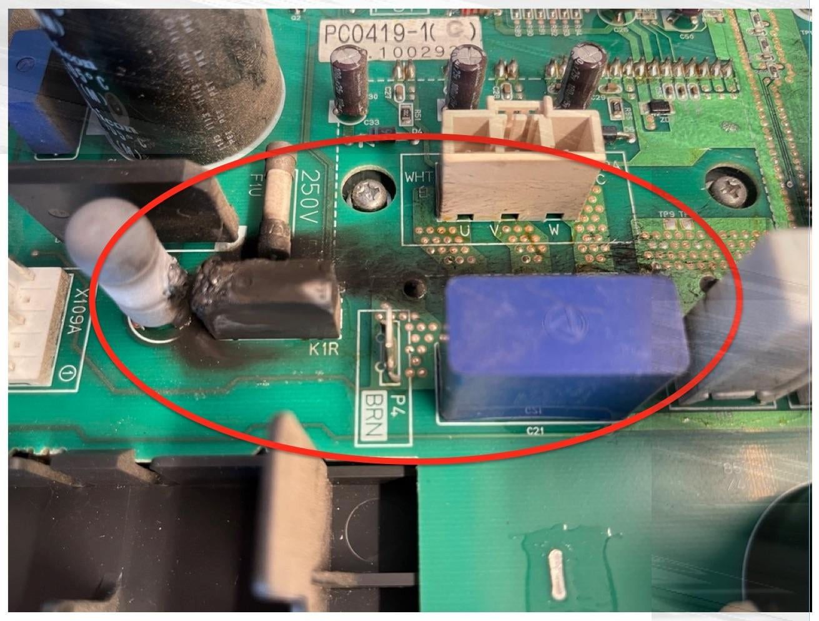
📌 Impact of Harmonics on Sensitive Electronics-Based Machines
Industrial PCB with Harmonics
Transformer over-heating and early insulation failures
Flashover/Failure of contactors/capacitors
VFD failures/Malfunction
PCB (SMPS/Inverter Circuit) Failures

Slide 17
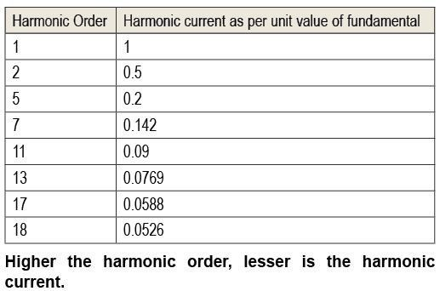
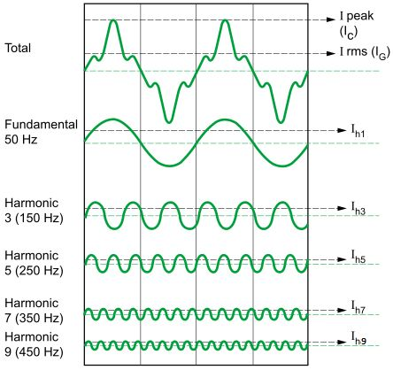
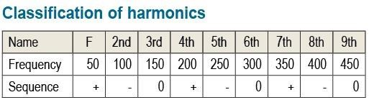
Theoretical value of the harmonic current = I/h
I = fundamental value of the current
h = Order of harmonics

Slide 18
🟢 Solution:
Eliminating harmonics reduces overall current consumption.
This leads to:
  Reduced loading on Transformers, DGs, Busbars & Cables
  Improved efficiency
  Longer equipment lifespan

Slide 19
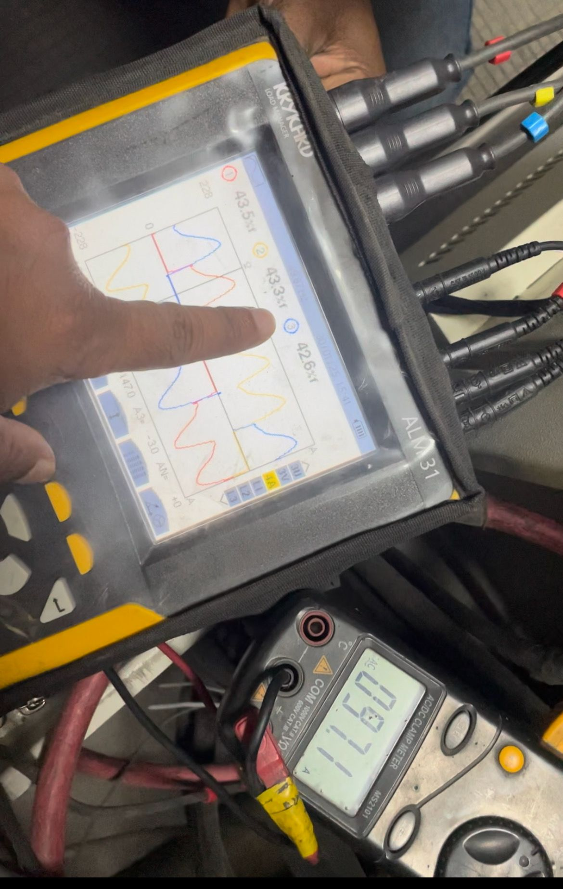
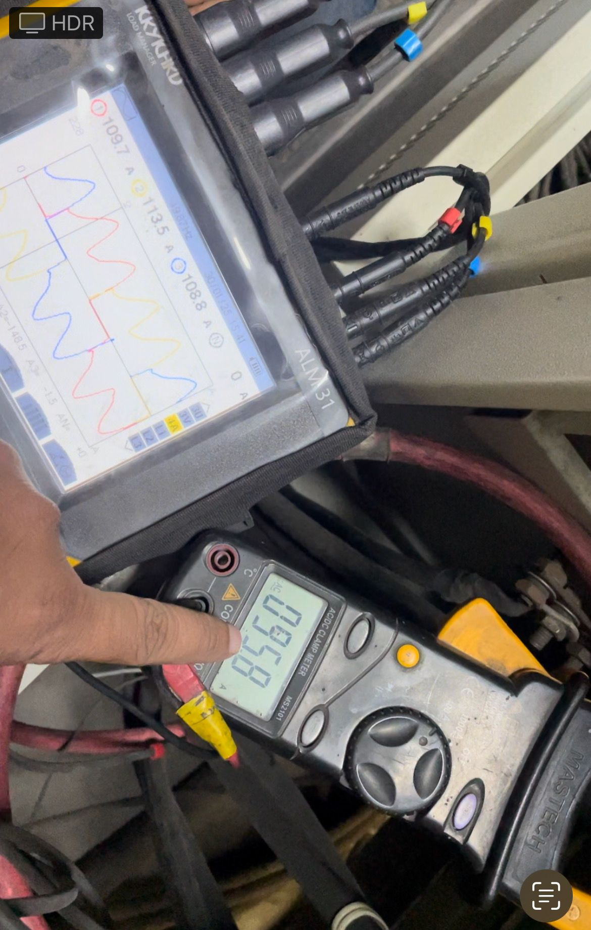
“Harmonics cause metering errors, which means you can never get an actual current measurement with plain RMS meters or clamp meters when harmonics are present in the network. For example:”
You can see in the above pictures that the RMS clamp meter connected on the Y-Phase is showing 18A less current compared to the True RMS current meter. This difference is called Metering Error. Therefore, always use a True RMS Clamp Meter for industrial and commercial loads to obtain accurate current measurements, especially when the current has iTHD% > 42.

Slide 20
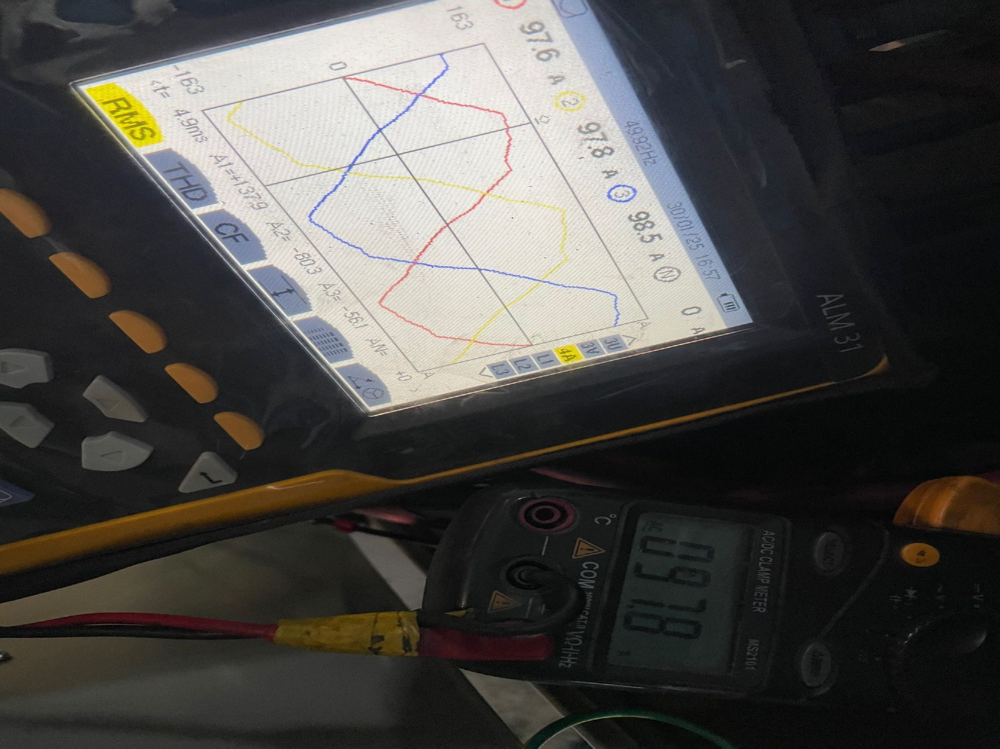
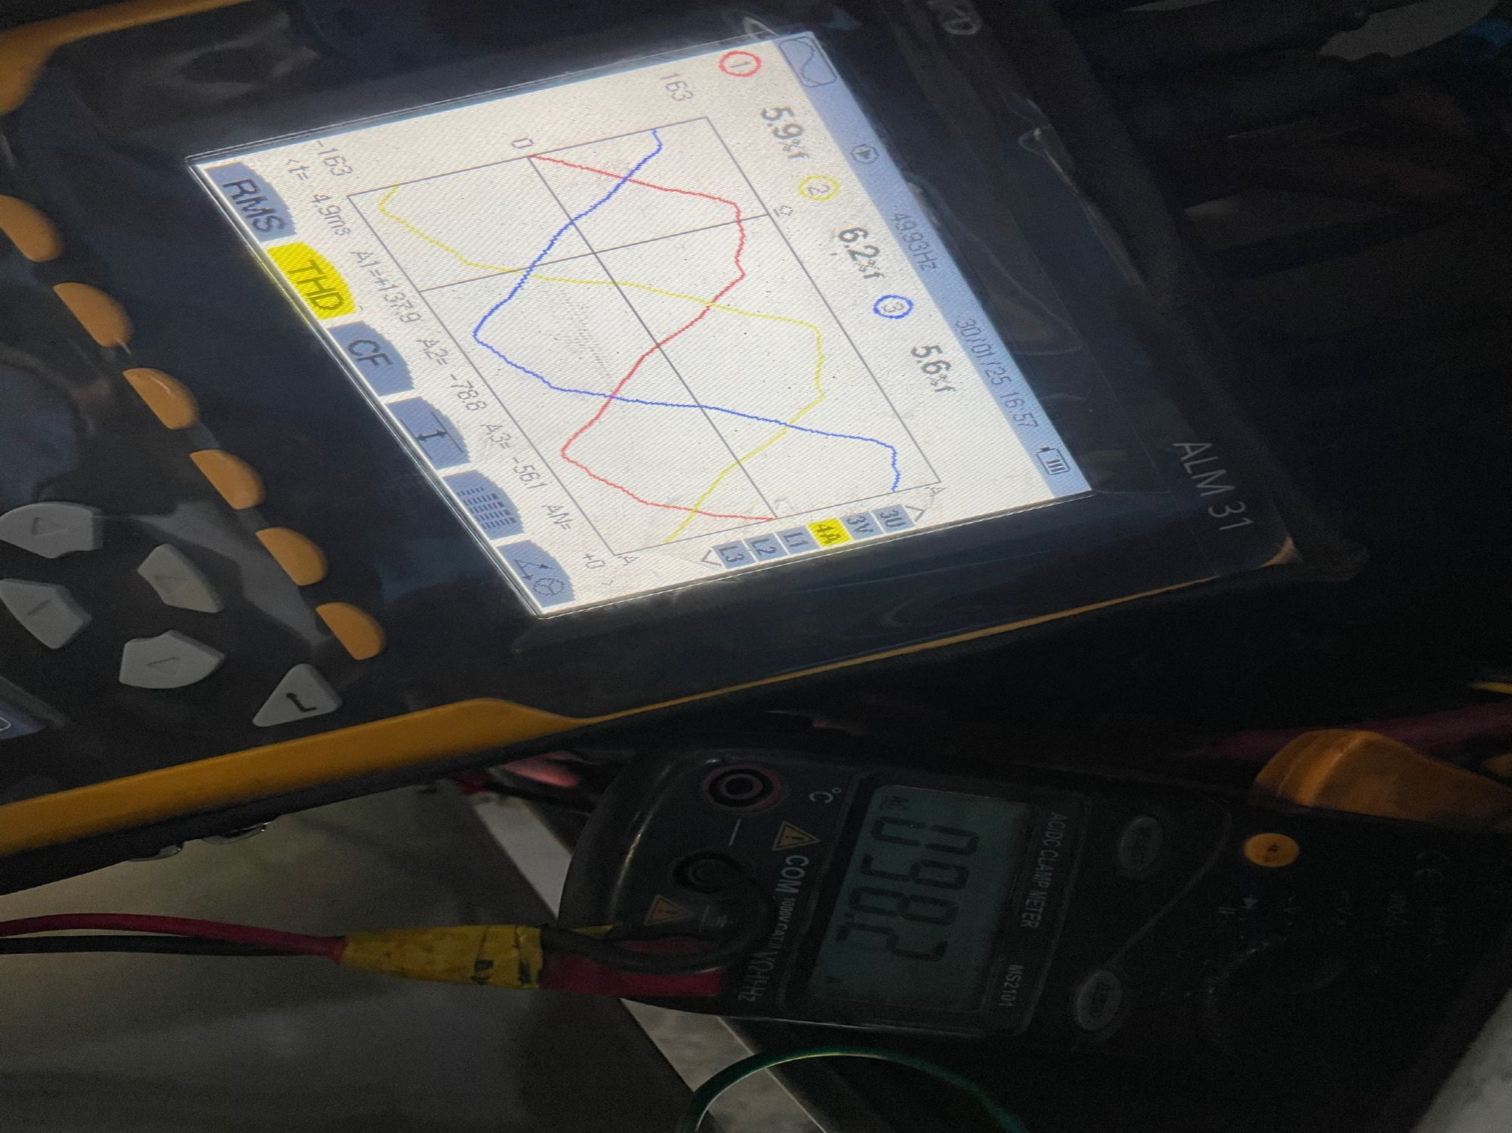
“In case of harmonic current (iTHD%) < 8, there will be no metering error. Plain RMS meters and True RMS meters will show the same current values, as shown in the pictures below.”
True RMS Current 97A with iTHD% <8.
Current with iTHD <8%.

Slide 21
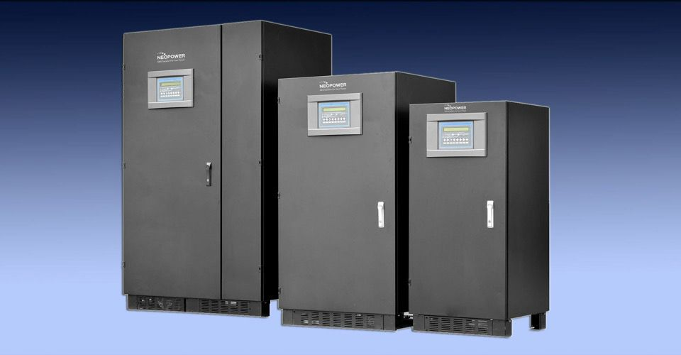
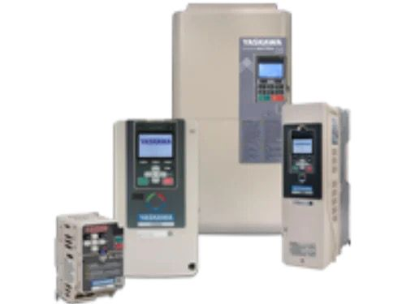
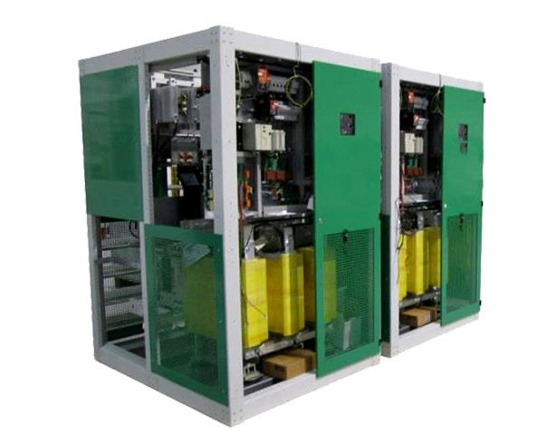
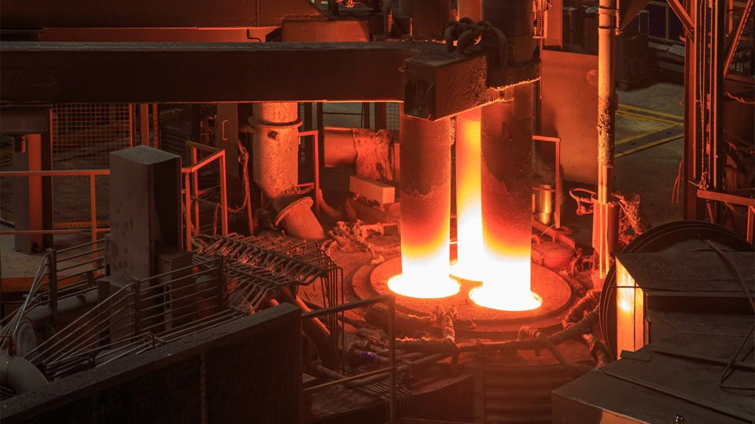
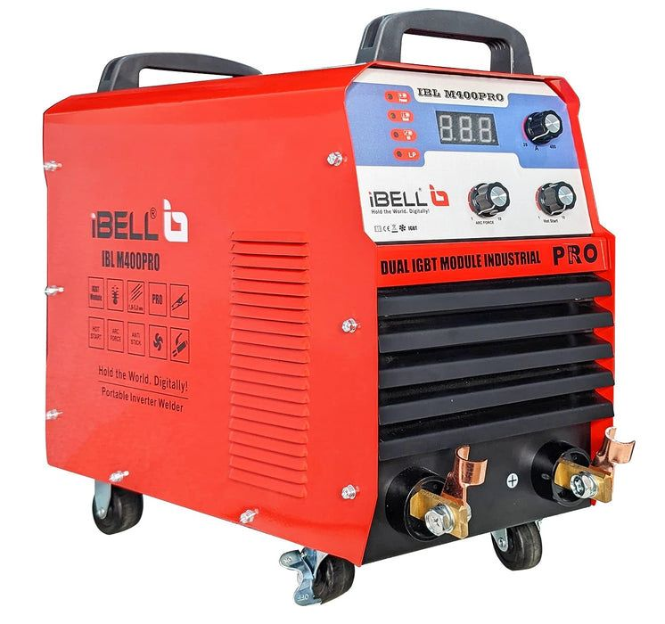
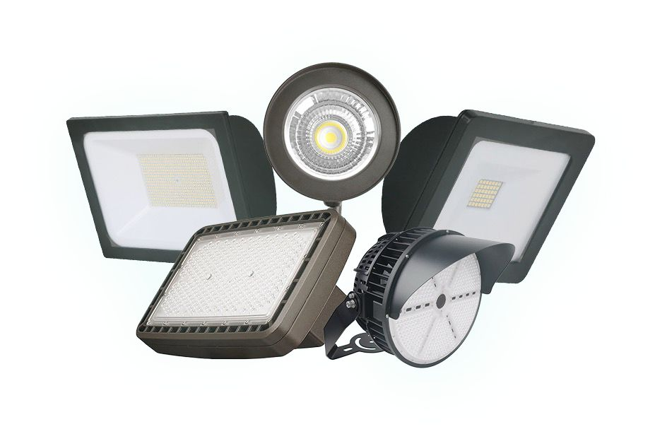
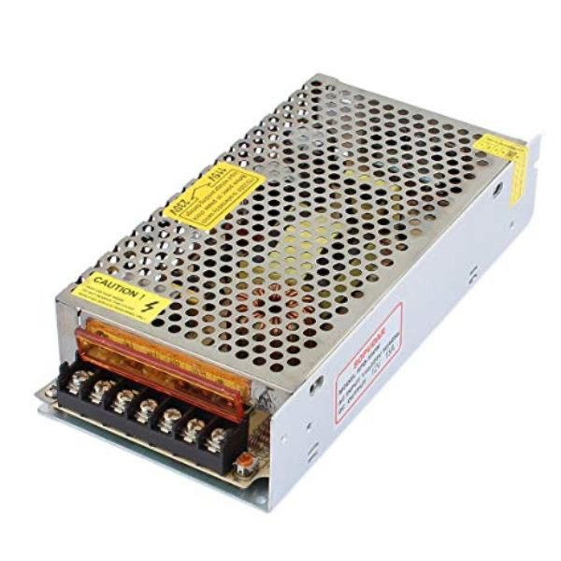
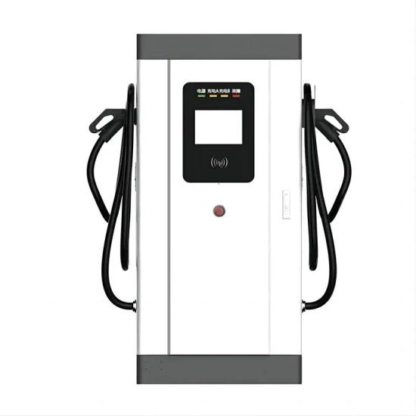
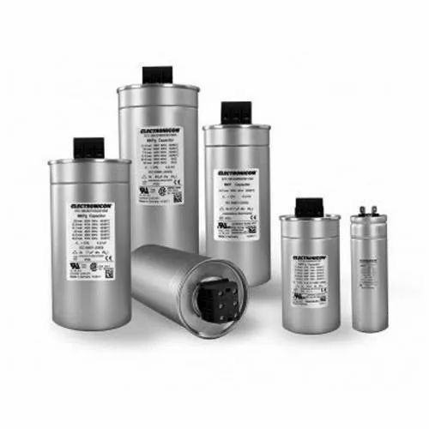

“Harmonics are caused by nonlinear loads that convert AC line voltage into DC.”
Industrial UPS
VFDs
Rectifiers
Arc Furnaces
Welding Machines
LED Lights
SMPS
EV Chargers
Power Capacitors
Personal Computers

Slide 22
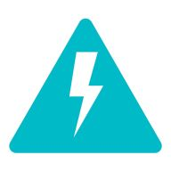
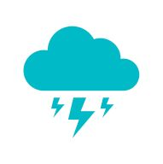
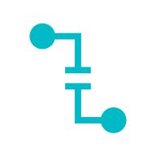
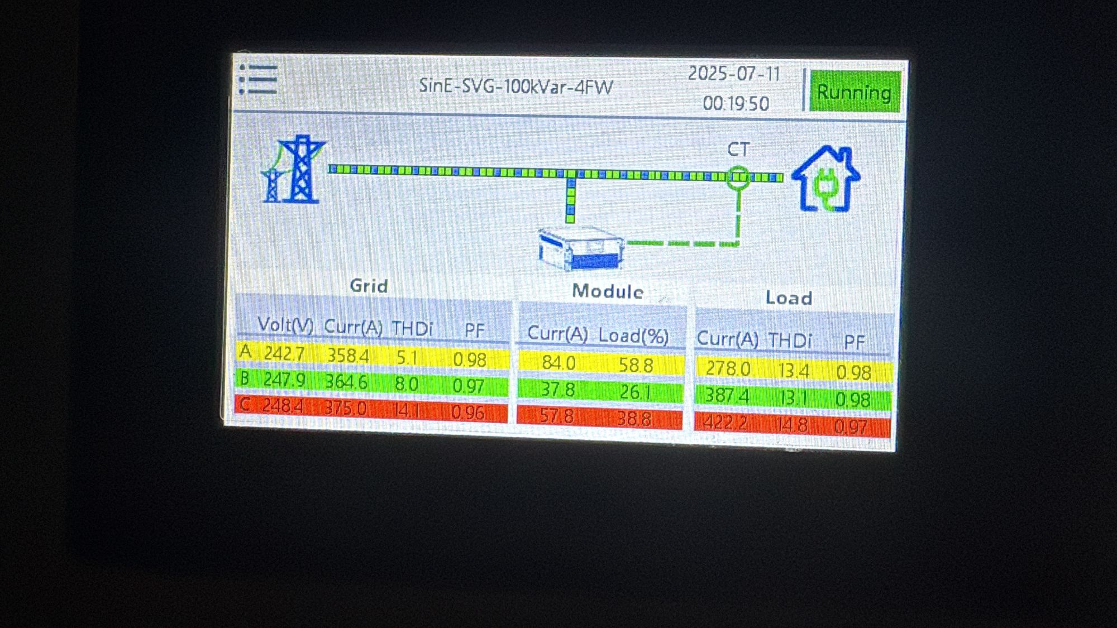

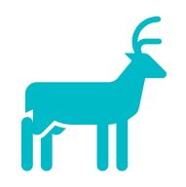

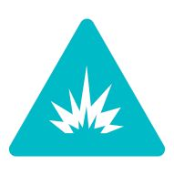
“These are the major disadvantages that we should keep in mind in the case of high harmonic components in the network.”
Higher the loads on electrical infrastructures due to non-sinusoidal current components.
Inefficiency & fast deterioration + failures of machines & sensitive electronics cards.
Higher the I2R losses means higher the KWH consumptions.
Malfunction of sensitive electronics - based machines.
Generators hunting.
Metering Error
Higher the current consumptions means higher the KVAh consumptions.

Slide 23
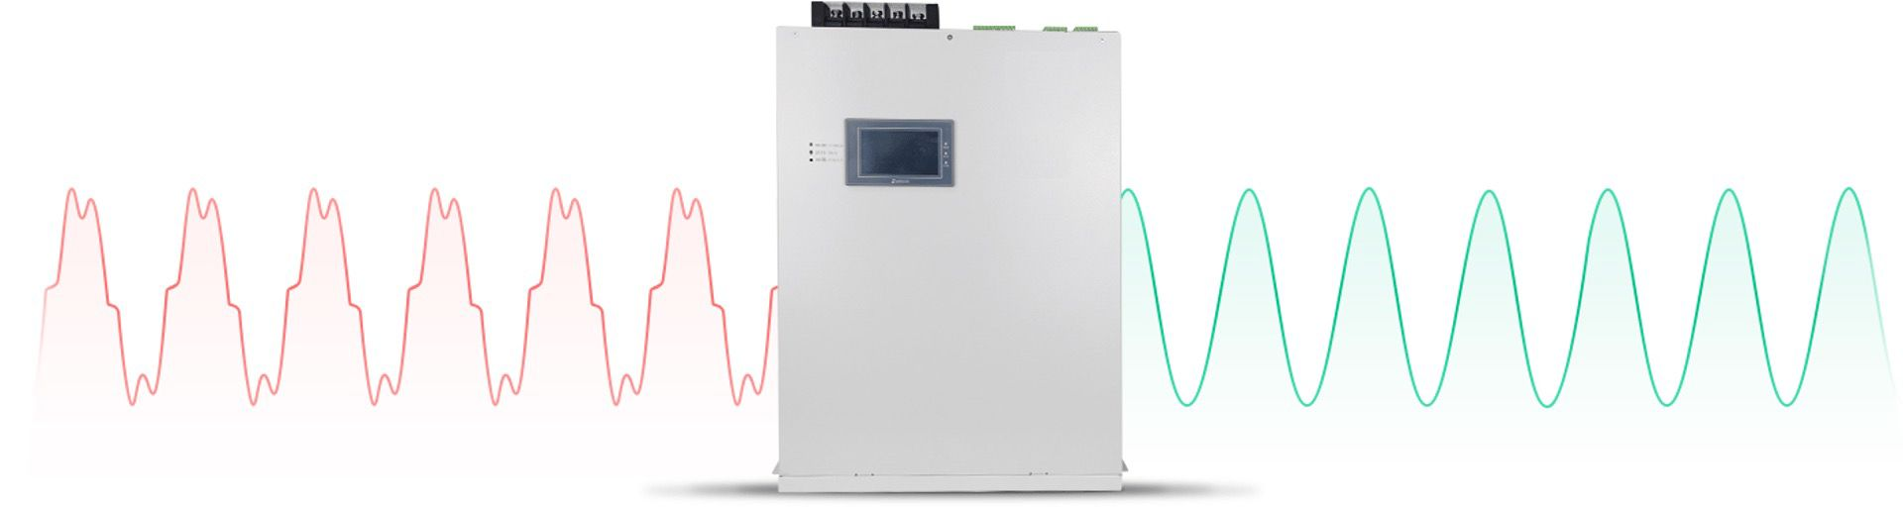
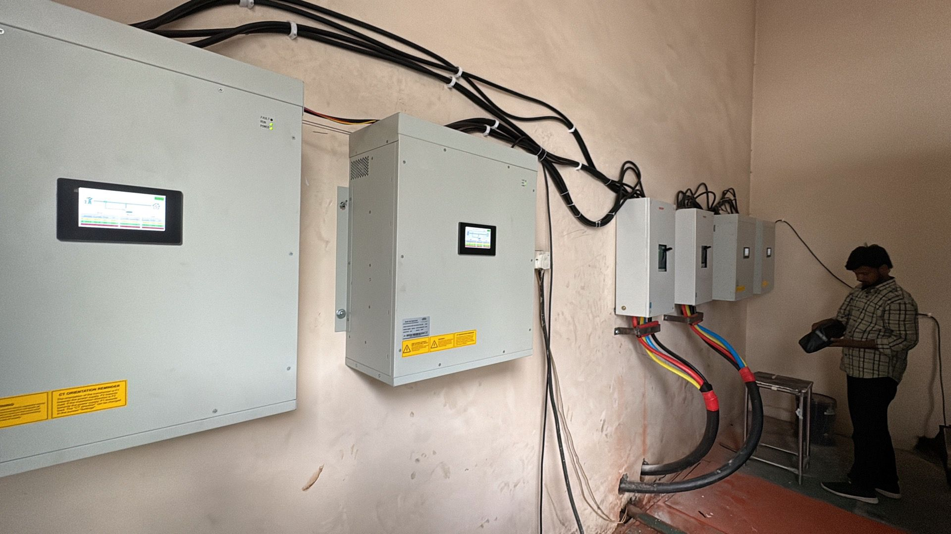
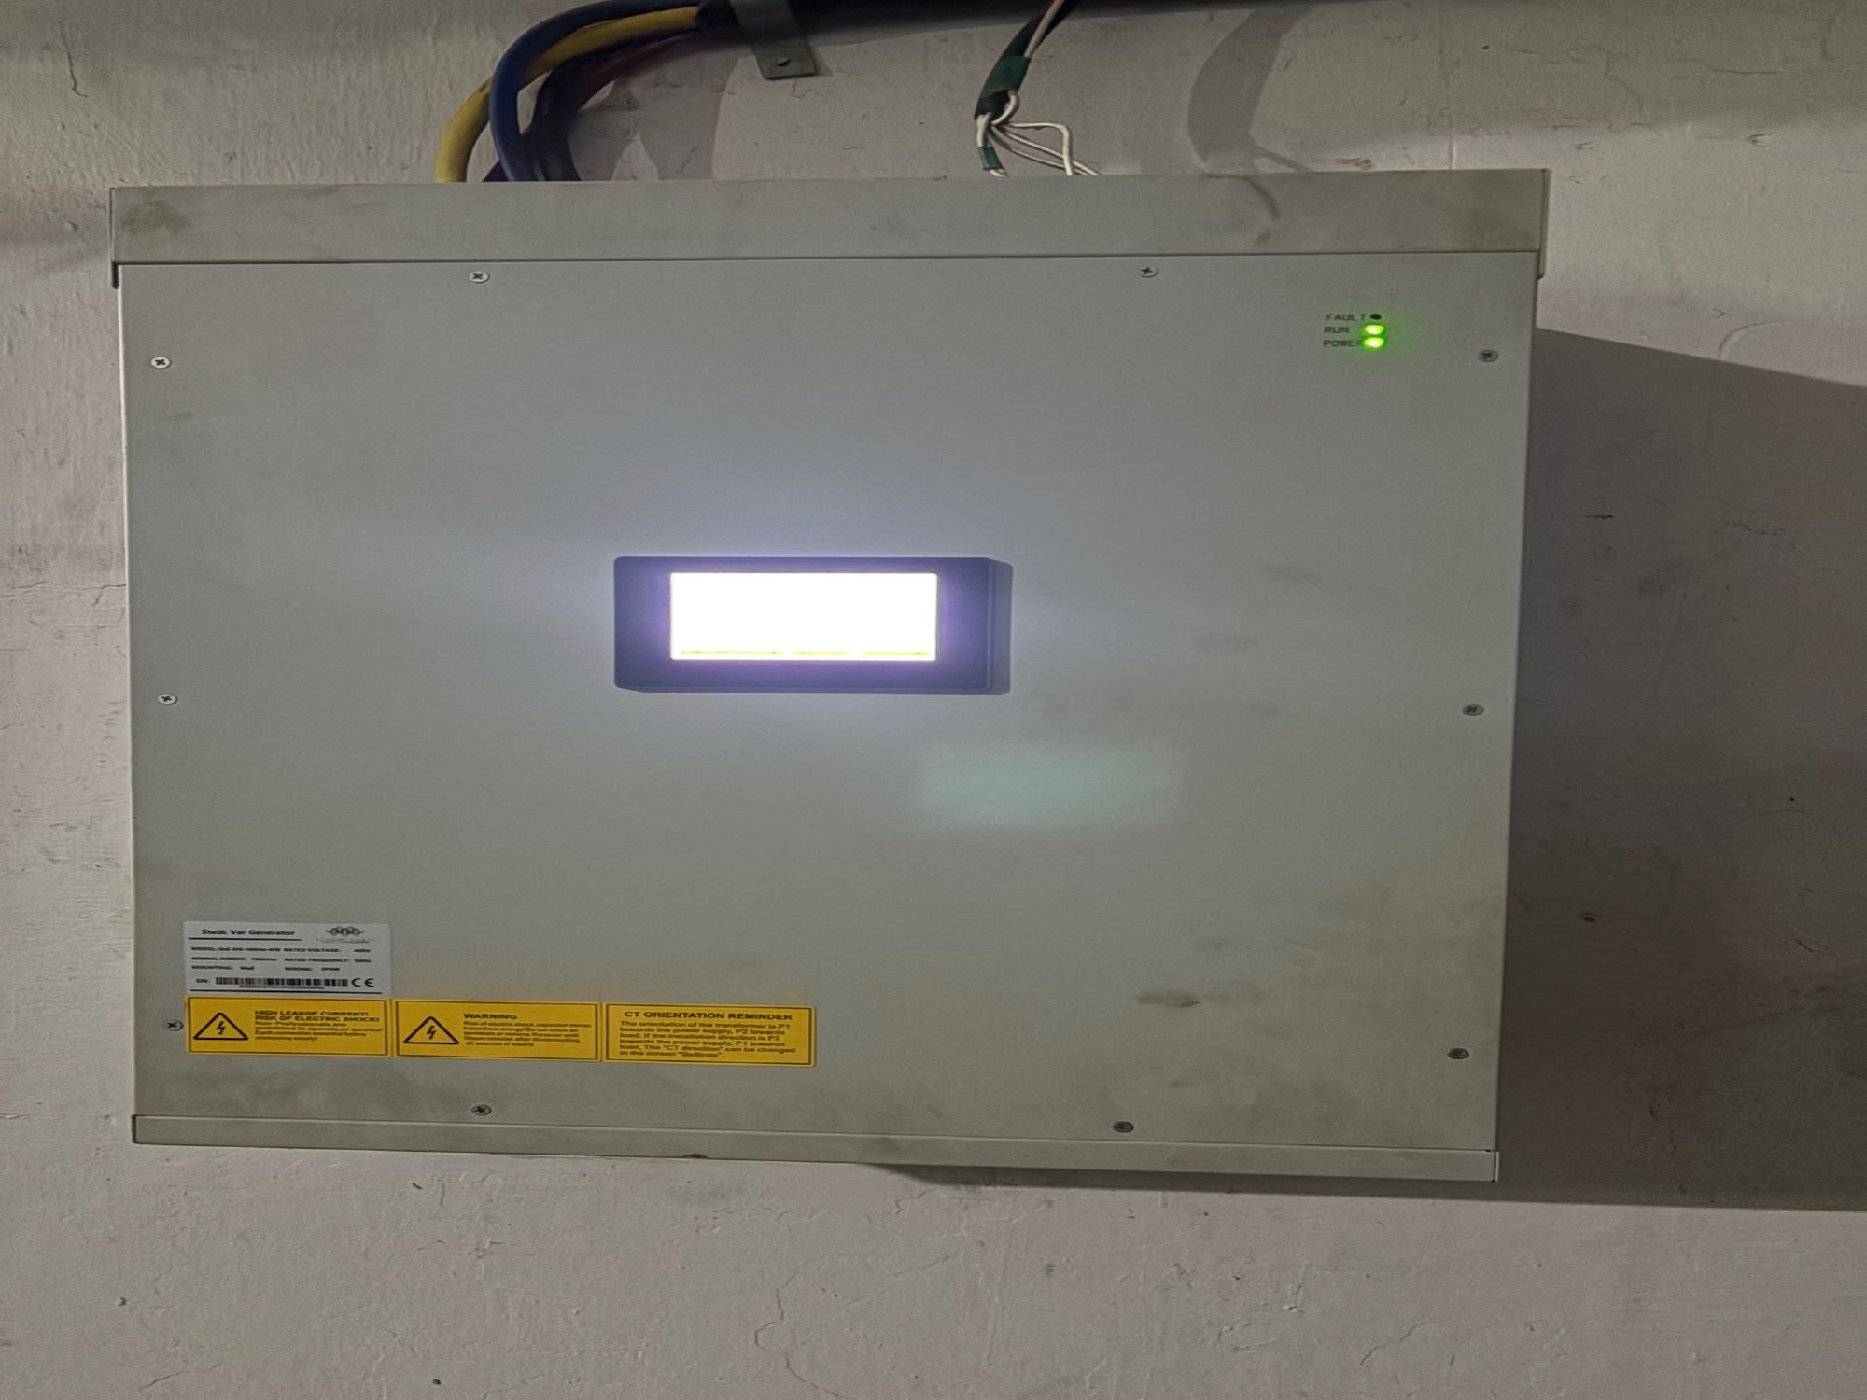
"PurityElec – Where clean energy meets smart solutions for small and big industries."

Slide 24


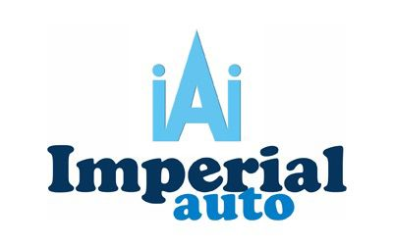
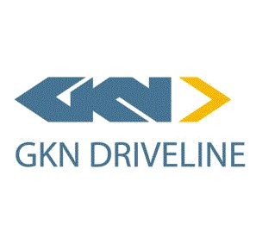
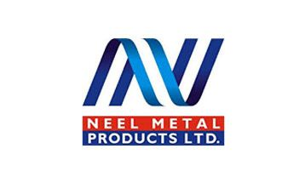





















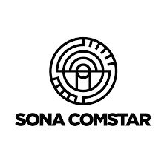



















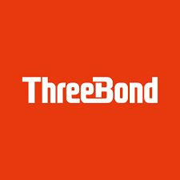

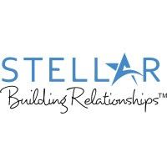




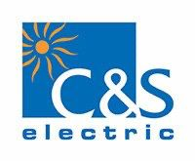





Our Clients

Slide 25




Thank you !
PurityElec Private Limited, 001-002, 1st Floor, C1 Tower, Engineers Enclave, Haldoni Mod, Greater Noida – 201306 (U.P.)
(+91) 8588001002 / 8588002004
support@purityelec.com
sales@purityelec.com
purityelec.com

